Slide 1
Chapter 3: INTEL 8086
Syed Shakil Mahmud
Lecturer
Department of Computer Science and Engineering
BAIUST, Cumilla

Slide 2
Main Features of 8086
8086 is a 16-bit microprocessor.
8086 has a 16-bit data bus.
8086 has a 20-bit address bus which means it can address up to 2∧20= 1MB memory location
Frequency range of the 8086 is 6-10 MHz.
The Intel 8086 is designed to operate in two modes, namely the minimum mode and the maximum mode.
The 8086 works in a multiprocessor environment.
It uses two stages of pipelining, i.e. Fetch Stage and Execute Stage, which improves performance.
It fetches up to six instruction bytes (4 instruction bytes for 8088) from memory and queue stores them in order to speed up instruction execution.
It requires +5 V power supply.
It uses a 40-pin dual in line package.
It has 256 interrupts.

Slide 3
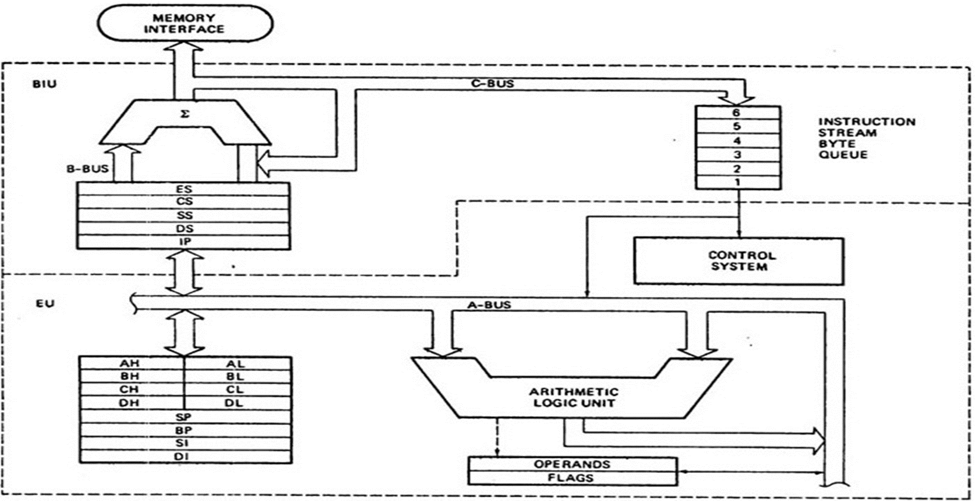
Internal Architecture of Intel 8086

Slide 4
Intel 8086 Microprocessor
8086 microprocessor has two units.
Bus Interface Unit (BIU).
Execution Unit (EU)
They are dependent and get worked by each other.

Slide 5
Bus Interface Unit(BIU)
BIU performs the following functions-
It generates the 20 bit physical address for memory access.
It fetches instruction from memory.
It transfers data to and from the memory and I/O.
It supports pipelining using the 6 byte instruction queue

Slide 6
Execution Unit (EU)
Execution Unit (EU) performs the following functions-
It fetches instructions from the Queue in BIU, decodes and executes them.
It performs arithmetic, logic and internal data transfer operations within the microprocessor.
It sends request signals to the BIU to access the external module.

Slide 7
Main Components of Bus Interface Unit (BIU)
The main components of the BIU are as follows:
4 Segment Registers
Instruction Pointer
Address Generation Circuit and
A prefetch queue

Slide 8
Main Components of BIU (Cont.)
Segment registers-
CS register: CS holds the base address for the Code Segment. All programs are stored in the Code Segment. CS is multiplied by 10H to give the 20 bit physical address of the Code Segment. E.g. If CS = 4321H then CS x 10H = 43210H→ Starting address of Code Segment.
DS register: DS holds the base address for the Data Segment. It is multiplied by 10H to give the 20 bit physical address of the Data Segment. E.g. If DS = 4321H then DS x 10H = 43210H→ Starting address of Data Segment.
SS register: SS holds the base address for the Stack Segment. It is multiplied by 10H to give the 20 bit physical address of the Stack Segment. E.g. If SS = 4321H then SS x 10H = 43210H→ Starting address of Stack Segment.
ES register: ES holds the base address for the Extra Segment. It is multiplied by 10H to give the 20 bit physical address of the Extra Segment. E.g. If ES = 4321H then ES x 10H = 43210H→ Starting address of Code Segment.

Slide 9
Main Components of BIU (Cont.)
Instruction Pointer (IP)-
It is a 16 bit register. It holds offset of the next instructions in the Code Segment.
Address of the next instruction is calculated as CS x 10H + IP.
IP is incremented after every instruction byte is fetched.
IP gets a new value whenever a branch occurs

Slide 10
Main Components of BIU (Cont.)
Address Generation Circuit-
The BIU has a Physical Address Generation Circuit. It generates the 20 bit physical address using Segment and Offset addresses using the formula: Physical Address = Segment Address x 10H + Offset Address

Slide 11
Main Components of BIU (Cont.)
6 Byte Pre-fetch Queue:
It is a 6 byte queue (FIFO).
Fetching the next instruction (by BIU from CS) while executing the current instruction is called pipelining.
Gets flushed whenever a branch instruction occurs.

Slide 12
Main Components of Execution Unit (EU)
The main components of the EU are as follows:
General purpose registers-
8086 microprocessor has four 16 bit general purpose registers AX, BX, CX and DX. These are available to the programmer for storing values during programs. Each of these can be divided into two 8 bit registers such as AH, Al; BH, BL; etc. Beside their general use, these registers also have some specific functions.
AX register (16 bits): It holds operands and results during multiplication and division operations. All I/O data transfers using IN and OUT instructions use A register (AL/AH or AX). It functions as accumulator during string operations.
BX register (16 bits): It holds the memory address (offset address) in indirect addressing modes.
CX register (16 bits): It holds count for instructions like loop, rotate, shift and string operations.
DX register (16 bits): It is used with AX to hold 32 bit values during multiplication and division. It is used to hold the address of the I/O port in indirect I/O addressing mode.

Slide 13
Main Components of EU (Cont.)
Special purpose registers-
Stack Pointer (SP 16 bits): It holds offset address of the top of the Stack. Stack is a set of memory locations operating in LIFO manner. Stack is present in the memory in Stack Segment. It is used during instructions like PUSH, POP, CALL, RET etc.
Base Pointer (BP 16 bits): BP can hold offset address of any location in the stack segment. It is used to access random locations of the stack.
Source Index (SI 16 bits): It is normally used to hold the offset address for Data Segment but can also be used for other segments using Segment Overriding. It holds offset address of source data in Data Segment during string operations.
Destination Index (DI 16 bits): It is normally used to hold the offset address for Extra Segment but can also be used for other segments using Segment Overriding. It holds offset address of destination in Extra Segment during string operations.

Slide 14
Main Components of EU (Cont.)
ALU (Arithmetic Logic Unit) - It has a 16 bit ALU. It performs 8 and 16 bit arithmetic and logic operations.
Operand register- It is a 16 bit register used by the control register to hold the operands temporarily. It is not available to the programmer.

Slide 15
Main Components of EU (Cont.)
Instruction Register and Instruction Decoder- The EU fetches an opcode from the queue into the instruction register. The instruction decoder decodes it and sends the information to the control circuit for execution.

Slide 16
Offset for the Specific Segment
Segment | Offset Registers | Function
CS | IP | Address of the next instruction
DS | BX, DI, SI | Address of data
SS | SP, BP | Address in the stack
ES | BX, DI, SI | Address of destination data (for string operations)

Slide 17
Question
The contents of the following registers are
CS=1111 H
DS=3333 H
SS=2526 H
IP=1232 H
SP=1100 H
DI=0020 H
Calculate the corresponding physical addresses for the address bytes in CS, DS and SS

Slide 18
Solution
CS = 1111 H
The base address of the code segment is 11110 H.
Effective address of memory is given by 11110H + 1232H = 12342H.
2. DS = 3333 H
The base address of the data segment is 33330 H.
Effective address of memory is given by 33330H + 0020H = 33350H.
3. SS = 2526 H
The base address of the stack segment is 25260 H.
Effective address of memory is given by 25260H + 1100H = 26350H

Slide 19
Main Components of EU (Cont.)
Flag register (16 bits)-
It has 9 flags.
These flags are of two types: 6 Status flags namely carry flag, parity flag, auxiliary carry flag, zero flag, sign flag, overflow flag and 3 Control flags namely trap flag, interrupt flag and direction flag.
Status flags are affected by the ALU after every arithmetic or logic operation. They give the status of the current result.
The Control flags are used to control certain operations. They are changed by the programmer.

Slide 20
Flag Register
Auxiliary Carry Flag
This is set, if there is a carry from the lowest nibble, i.e, bit three during addition, or borrow for the lowest nibble, i.e, bit three, during subtraction.
Carry Flag
This flag is set, when there is a carry out of MSB in case of addition or a borrow in case of subtraction.
Sign Flag
This flag is set, when the result of any computation is negative
Zero Flag
This flag is set, if the result of the computation or comparison performed by an instruction is zero
Parity Flag
This flag is set to 1, if the lower byte of the result contains even number of 1’s ; for odd number of 1’s set to zero.
15 | 14 | 13 | 12 | 11 | 10 | 9 | 8 | 7 | 6 | 5 | 4 | 3 | 2 | 1 | 0
U | U | U | U | OF | DF | IF | TF | SF | ZF | U | AF | U | PF | U | CF
Over flow Flag
This flag is set, if an overflow occurs, i.e, if the result of a signed operation is large enough to accommodate in a destination register. The result is of more than 7-bits in size in case of 8-bit signed operation and more than 15-bits in size in case of 16-bit sign operations, then the overflow will be set.
Trap Flag
If this flag is set, the processor enters the single step execution mode by generating internal interrupts after the execution of each instruction
Direction Flag
This is used by string manipulation instructions. If this flag bit is ‘0’, the string is processed beginning from the lowest address to the highest address, i.e., auto incrementing mode. Otherwise, the string is processed from the highest address towards the lowest address, i.e., auto decrementing mode.
Interrupt Flag
Causes the 8086 to recognize external mask interrupts; clearing IF disables these interrupts.

Slide 21
Flag Register Calculation
Example:
1. Identify flag registers for the following operations of Hexadecimal numbers:
i. 41+4F
ii. 37+01
iii. 9E+D3

Slide 22
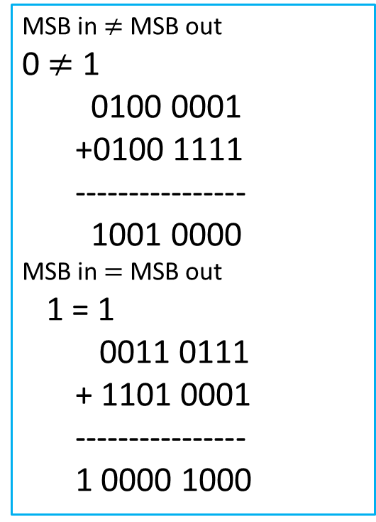
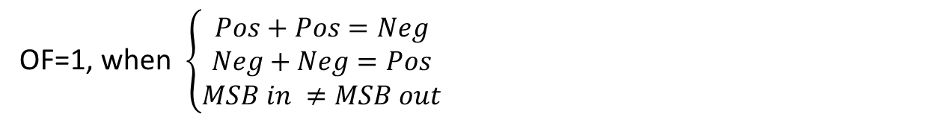
Flag Register Calculation (Solution)
Example:
1. Flag registers for the following operations of Hexadecimal numbers:
i. 41+4F (CF=0, SF=1, PF=1, ZF=0, OF=1, AF=1)
ii. 37+01 (CF=1, SF=0, PF=0, ZF=0, OF=0, AF=0)
iii. 9E+D3 (CF=1, SF=0, PF=1, ZF=0, OF=1, AF=1)
MSB in $≠$ MSB out
0 $≠$ 1
0100 0001
+0100 1111
----------------
1001 0000
MSB in $=$ MSB out
1 = 1
0011 0111
+ 1101 0001
----------------
1 0000 1000
OF=1, when $\left\{\begin{aligned}Pos+Pos=Neg \\ Neg+Neg=Pos \\ MSB in ≠MSB out\end{aligned}\right.$

Slide 23
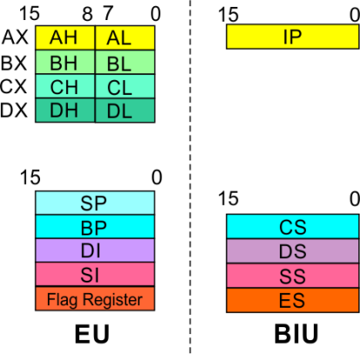
8086 Microprocessor Registers
8086 registers categorized into groups
15 | 14 | 13 | 12 | 11 | 10 | 9 | 8 | 7 | 6 | 5 | 4 | 3 | 2 | 1 | 0
 |  |  |  | OF | DF | IF | TF | SF | ZF |  | AF |  | PF |  | CF
Sl.No. | Type | Register width | Name of register
1 | General purpose register | 16 bit | AX, BX, CX, DX
 |  | 8 bit | AL, AH, BL, BH, CL, CH, DL, DH
2 | Pointer register | 16 bit | SP, BP
3 | Index register | 16 bit | SI, DI
4 | Instruction Pointer | 16 bit | IP
5 | Segment register | 16 bit | CS, DS, SS, ES
6 | Flag (PSW) | 16 bit | Flag register

Slide 24
Pin Diagram of 8086

Slide 25
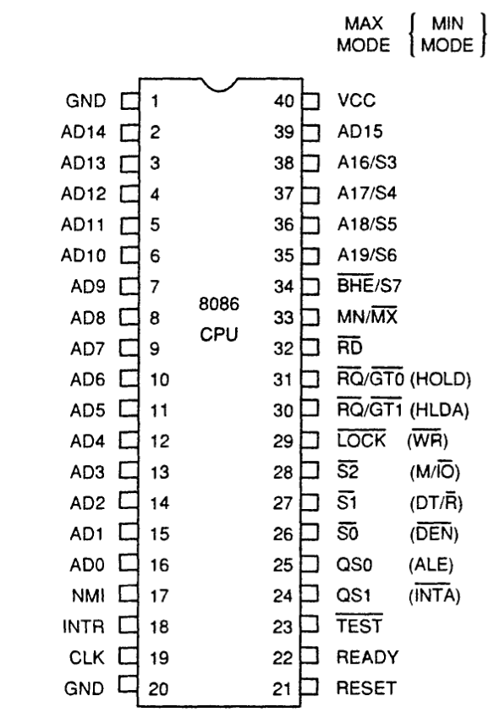
Pin Diagram of 8086

Slide 26
Intel 8086-Pin Details
Min/Max mode
Minimum Mode: +5V
Maximum Mode: 0V
Minimum Mode Pins
Maximum Mode Pins

Slide 27
Pin Functions
Out of 40 pins, 32 pins are having same function in minimum or maximum mode,
And remaining 8 pins are having different functions in minimum and maximum mode.
Following are the pins which are having same functions

Slide 28
Common Pin Description
V_{CC} – Pin number 40 – At this pin, the external power supply of + 5V is provided to the processor.
V_{SS} – Pin number 1 and 20 – These two pins acts as the ground. This pin directs the extra current of the microprocessor to ground.

Slide 29
Common Pin Description
AD₀ – AD₁₅ – Pin number 2 to 16 and 39 – These are the multiplexed address and data bus.
We know that the 8086 microprocessor has 20-bit address bus and 16-bit data bus. So, the 16 lines of the address and data bus are multiplexed together so as to reduce the number of lines inside the IC.
Notes:
We are aware of the fact that at a time either address or data will be transmitted by the bus. So, at a particular time only either the address or the data bus will be enabled from the multiplexed buses.

Slide 30
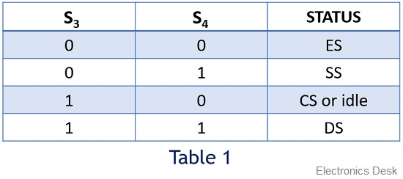
Common Pin Description
A₁₆/S₃, A₁₇/S₄, A₁₈/S₅ and A₁₉S₆ – Pin number 35 to 38 – Out of 20 address bits, 4 are present in the multiplexed form with the status signals. In the case of memory operations, these pins act as an address bus and contain the memory address of any particular instruction or data.
However, from I/O operations these pins are low that shows the status of the processor.
Basically, the signal at S₃ and S₄ show that which segment is currently accessed by the microprocessor among the four segments present in it.
The table below will show the encoding of S₃ and S₄:

Slide 31
Common Pin Description
Also, S₅, when enabled, shows the presence of an interrupts in the microprocessor. So, basically, it serves as an interrupt flag.
The signal at S₆ shows the status of the bus master for the current operation. More simply we can say, whether the 8086 is the bus master or any other proficient device is acting as the bus master.
When 0 is present as the signal at this pin then it indicates the 8086 is holding the access of the bus otherwise it is high i.e., 1.

Slide 32
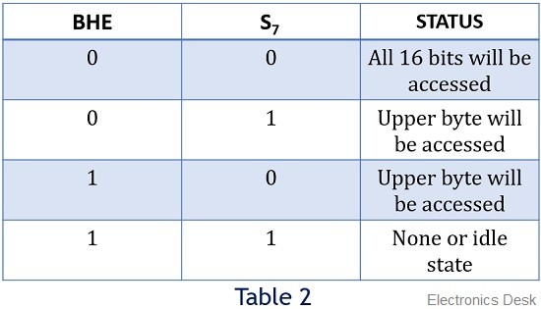
Common Pin Description
BHE’ / S₇ – Pin number 34 – BHE is an acronym for Bus High Enable. The combination of the BHE signal and S₇ status informs about the existence of the data on the bus. Also, different combinations show whether the bus is containing overall 16 bit, upper byte or lower byte of the data.
The table below represents the status for the signal at this pin:

Slide 33
Common Pin Description
MN/MX’ – Pin number 33 –The status at this particular pin shows whether the processor is operating in the minimum mode or maximum mode.
A signal 0 at this pin informs that the 8086 is operating in maximum mode i.e., multiple processors. While signal 1 shows the operation under minimum mode i.e., single processor.

Slide 34
Commmon Pin Description
RD’ – Pin number 32 – An active low signal at this pin shows that the microprocessor is performing read operation with either memory or I/O devices.
CLK – Pin number 19 – A signal at this pin provides the timing to the internal operations that are being executed inside the microprocessor.

Slide 35
Common Pin Description
NMI – Pin number 17 – NMI is Non-maskable interrupt. These are basically uncontrollable interrupts generated inside the processor. When an NMI occurs, then an interrupt service routine is generated by the interrupt vector table.
TEST – Pin number 23 – This pin basically shows the wait instruction. Whenever a low signal at this pin occurs then the processing inside the processor continues. As against, in case of the high signal, the processor has to wait for the disabling of this pin.

Slide 36
Common Pin Description
INTR – Pin number 18 – INTR stands for an interrupt request. The processor after each clock cycle samples the INTR and if the signal at this pin is found to be high then the processor controls that interrupt internally.
READY – Pin number 22 – This signal is used by the peripherals and memory devices in order to show the readiness for the next operation.
RESET – Pin number 21 – Whenever this pin is enabled then it resets the processor and other devices connected to the system by immediately terminating the recent task.

Slide 37
Pins in Minimum Mode
INTA’ – Pin number 24 – It is an interrupt acknowledge pin. Whenever an INTR signal is generated, then the microprocessor generates INTA signal, as a response to that interrupt.
ALE –Pin number 25 -Address Latch Enable:
When high, multiplexed address/data bus contains address information
.
Notes:
Pin number 25 – ALE is an abbreviation for address latch enable. Whenever an address is present in the multiplexed address and data bus, then the microprocessor enables this pin.
This is done to inform the peripherals and memory devices about fetching of the data or instruction at that memory location.

Slide 38
Pins in Minimum Mode
DEN’ – Pin number 26 – DEN is used for data enable. This is an active low pin that means whenever a 0 is present at this pin then the transceiver gets enabled and it separates the data from the multiplexed address and data bus.
DT/R’ – Pin number 27 – This pin is used to show whether the data is getting transmitted or is received. A high signal at this pin indicates that data is being transmitted. While a low indicates reception of data.
.
.

Slide 39
Pins in Minimum Mode
M/IO’ – Pin number 28 – This pin indicates whether the processor is performing an operation with memory or I/O devices. Whenever a high is present at this pin then it shows the operation is carried out through the memory. While a low signal shows operation through I/O devices.
WR’ – Pin number 29 – An active low signal at this pin indicates that the processor is performing write operation from either memory or I/O devices.
HOLD – Pin number 31 – When an external device enables this pin then the processor stops accessing the buses immediately after the recent task gets over.
HLDA – Pin number 30 – This pin is used as a response pin for the hold request. Once request for accessing the buses is produced by an external entity. Then the microprocessor acknowledges the device that its request will be considered once it gets over by the current operation..
.

Slide 40
Pins in Maximum Mode
S₀‘, S₁‘ and S₂‘ – Pin number 26 to 28 – These are basically 3 status pins and are active low. This means that if the status at all the 3 pins is 0 then it shows that multiple interrupts are to be handled in maximum mode.
The table below is representing the status of the processor in different combinations:
S2 | S1 | S0 | Characteristics
0 | 0 | 0 | Interrupt acknowledge
0 | 0 | 1 | Read I/O port
0 | 1 | 0 | Write I/O port
0 | 1 | 1 | Halt
1 | 0 | 0 | Code access
1 | 0 | 1 | Read memory
1 | 1 | 0 | Write memory
1 | 1 | 1 | Passive state

Slide 41
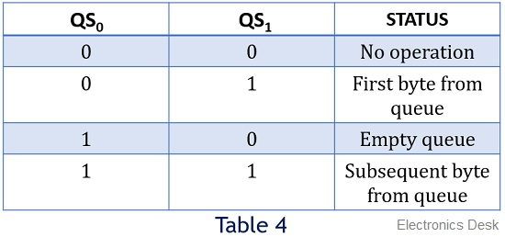
Pins in Maximum Mode
QS₀ and QS₁ – Pin number 24 and 25 – These two pins indicate the status of the 6-byte pre-fetch queue present in the architecture of 8086.

Slide 42
Pins in Maximum Mode
LOCK’ – Pin number 29 –This pin is involved in maximum mode operation. So, basically, when a single processor is accessing the buses and peripherals then it locks the resources being used by it. So, that no other entity can access it until the recent processor frees it.
RQ’/ GT₀‘ and RQ’/ GT₁‘ – Pin number 30 and 31 – Due to the involvement of multiple processors, these pins indicate the request and grant permission for accessing the buses, memory and peripherals.

Slide 43
Addressing Modes of 8086

Slide 44
Addressing Mode
The addressing mode is the method to specify the operand of an instruction. The job of a microprocessor is to execute a set of instructions stored in memory to perform a specific task. Operations require the following:
The operator or opcode - determines what will be done
The operands - define the data to be used in the operation
An assembly language program instruction consists of two parts
Example: ADD 7,8
Opcode | Operand

Slide 45
Addressing Mode
IMPORTANT TERMS
Starting address of memory segment.
Effective address or Offset: An offset is determined by adding any combination of three address elements: displacement, base and index.
Displacement: It is an 8 bit or 16 bit immediate value given in the instruction.
Base: Contents of base register, BX or BP.
Index: Content of index register SI or DI.

Slide 46
Types of 8086 Addressing Mode
The 8086 has 8 basic addressing modes (register, immediate and memory).
The basic and other 8086 addressing modes can be classified into five groups:
Addressing modes for accessing immediate and register data (register and immediate mode)
Addressing modes for accessing data in memory (memory modes)
Addressing modes for accessing I/O ports (I/O modes)
Relative addressing mode
Implied addressing mode

Slide 47
Types of Addressing Mode
Addressing modes for accessing immediate and register data (register and immediate mode)
1) Register addressing mode-
• In this mode, operands are specified using registers. This addressing mode is normally preferred because the instructions are compact and fastest executing of all instruction forms.
• Registers may be used as source operands, destination operands or both.
• Example:
• MOV AX, BX
• This instruction copies the contents of BX register into AX register.
AX ← BX

Slide 48
Types of Addressing Mode
2) Immediate addressing mode-
• In this mode, the operand is specified in the instruction itself. Instructions are longer but the operands are easily identified.
• Example:
• MOV CL, 12H
• This instruction moves 12 immediately into CL register. CL ← 12H

Slide 49
Types of 8086 Addressing Mode
Addressing modes for accessing data in memory (memory modes)
1) Direct addressing mode
2) Register indirect addressing mode
3) Based addressing mode
4) Indexed addressing mode
5) Based indexed addressing mode
6) String addressing mode

Slide 50
Types of Addressing Mode
Addressing modes for accessing data in memory (memory modes)
1) Direct addressing mode
• In this mode, the 16-bit effective address(EA) is directly included with the instruction.
• Example:
• MOV CX, DS:START
• This instruction moves the 16-bit contents of a 20-bit physical memory location computed from START and DS into CX.

Slide 51
Types of Addressing Mode
2) Register indirect addressing mode
• In this mode, the effective address (EA) is specified in either a pointer or an index register.
• The pointer register can be either base register BX or base pointer register BP and index register can be either the Source Index (SI) register or the Destination Index (DI) register.
• The 20-bit physical address is computed using DS and EA.
• Example:
• MOV [DI], BX
• The destination operand of the above instruction is in register indirect mode, while the source operand is in register mode.
• This instruction moves the 16-bit content of BX into a memory location offset by the value of EA specified in DI from the current contents in DS*16.
Notes:
Register indirect addressing mode
This addressing mode allows data to be addressed at any memory location through an offset address held in any of the following registers: BP, BX, DI & SI.
Example
MOV AX, [BX] ; Suppose the register BX contains 4895H, then the contents ; 4895H are moved to AX
ADD CX, {BX}

Slide 52
Types of Addressing Mode
3) Based addressing mode
• In this mode, EA is obtained by adding an 8 bit or a 16 bit displacement value to the contents of BX or BP.
• Example:
• MOV AL, START [BX]
• The source operand in the above instruction is in based mode.
• EA is obtained by adding the value of START and BX.
• The 20-bit physical address is produced from DS and EA.
• The 8-bit content of this memory location is moved to AL. The displacement START can be either 16-bit or 8-bit.
Notes:
Based addressing mode
In this addressing mode, the offset address of the operand is given by the sum of contents of the BX/BP registers and 8-bit/16-bit displacement.
Example
MOV DX, [BX+04], ADD CL, [BX+08]

Slide 53
Types of Addressing Mode
4) Indexed addressing mode-
In this addressing mode, the EA is calculated by adding the contents of SI or DI register and 8-bit/16-bit displacements.
Example
MOV BH, ARRAY[SI]
This instruction moves the contents of the 20-bit address computed from the displacement ARRAY, SI and DS into BH.

Slide 54
Types of Addressing Mode
5) Based indexed addressing mode-
• Here, EA is calculated as base register (BX or BP), an index register (SI or DI), and a displacement..
• Example:
• MOV ALPHA [SI] [BX], CL
• This instruction moves the 8-bit content of CL to 20-bit physical address ALPHA+SI+BX+DS.
Notes:
Based-indexed addressing mode
In this addressing mode, the offset address of the operand is computed by summing the base register to the contents of an Index register.
Example
ADD CX, [BX+SI], MOV AX, [BX+DI]

Slide 55
Types of Addressing Mode
6) String addressing mode
• Employed in string operations to operate on string data.
The effective address (EA) of source data is stored in SI register and the EA of destination is stored in DI register.
Segment register for calculating base address of source data is DS and that of the destination data is ES
• Example:
MOVS BYTE

Slide 56
Types of Addressing Mode
Addressing modes for accessing I/O ports (I/O modes)
Standard I/O uses port addressing modes. Two types:
i) I/O mode (direct):
Port number is an 8-bit immediate operand.
Example: OUT 05 H, AL
Outputs [AL] to 8 bit port 05 H
ii) I/O mode (indirect):
The port number is taken from DX.
Example 1: IN AL, DX
If [DX] = 5040
8 bit content by port 5040 is moved into AL.
Example 2: IN AX, DX
Inputs 8 bit content of ports 5040 and 5041 into AL and AH respectively.

Slide 57
Types of Addressing Mode
Relative addressing mode
• Instructions using this mode specify the operand as a signal 8-bit displacement relative to PC.
• Example:
• JNC START
• This instruction means that if carry=0, then PC is loaded with current PC contents plus the 8-bit value of START; otherwise the next instruction is executed.

Slide 58
Types of Addressing Mode
Implied addressing mode
• Instruction using this mode have no operands.
• Example:
• CLC
• This clears the carry flag to zero.

Slide 59
Instruction Set of 8086 Microprocessor

Slide 60
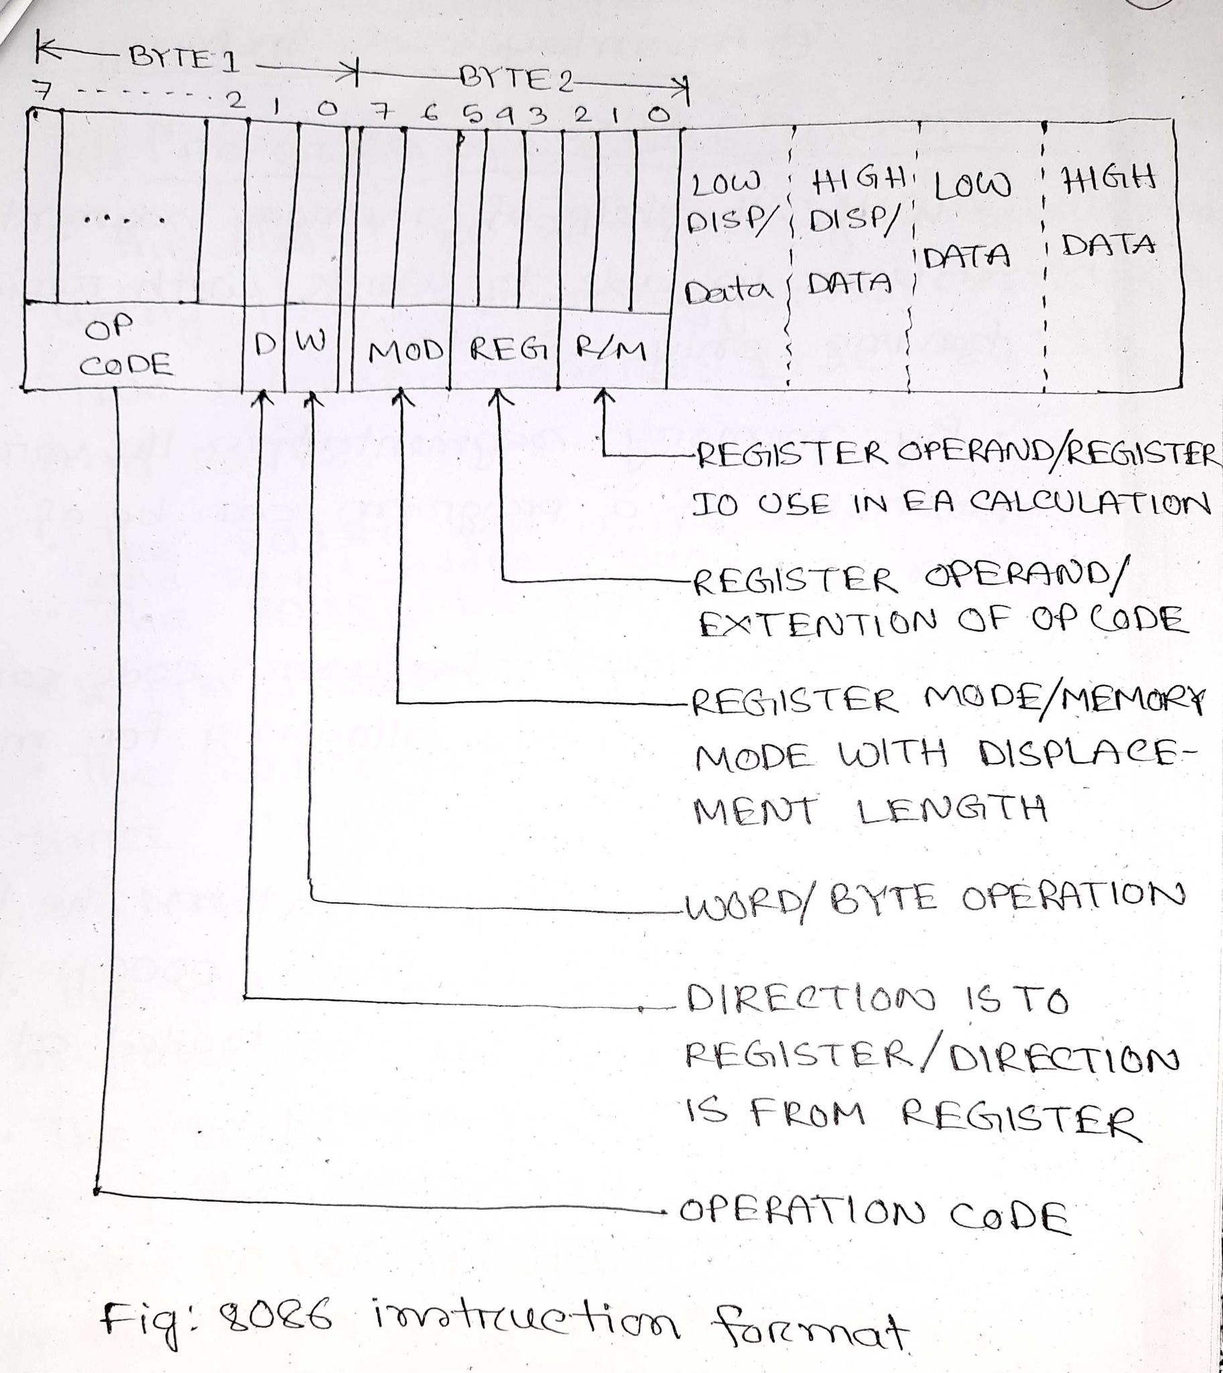
Instruction Set of 8086

Slide 61
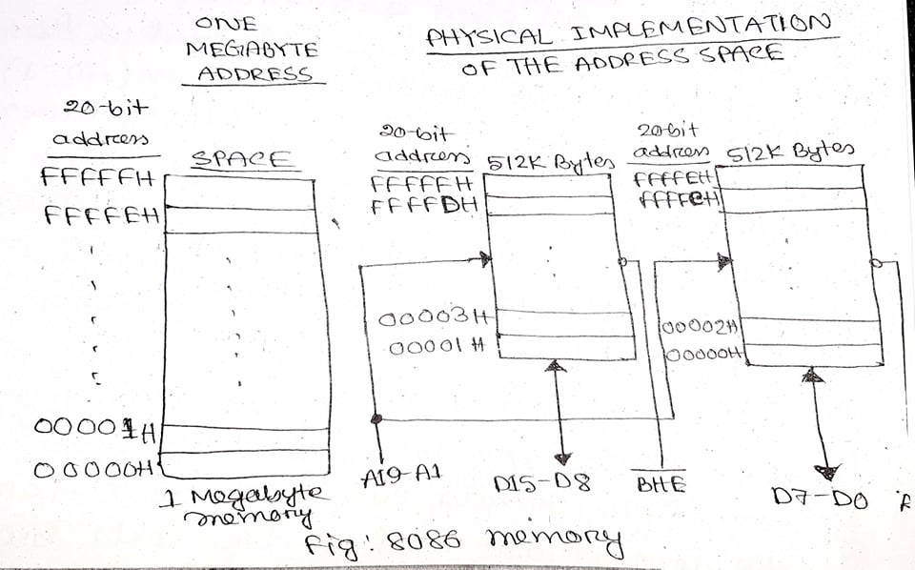
Accessing words from odd address takes longer time than even address

Slide 62
Offset for the Specific Segment
Segment | Offset Registers | Function
CS | IP | Address of the next instruction
DS | BX, DI, SI | Address of data
SS | SP, BP | Address in the stack
ES | BX, DI, SI | Address of destination data (for string operations)

Slide 63
Example:
Determine the effect of each one of the following 8086 instructions:
i) PUSH [BX]
ii) DIV DH
iii) CWD
iv) MOVSB
v) MOV START [BX], AL
Assume the following data prior to execution of each one of the above instructions independently.
[DS] = 3000H | [SI] = 0400H | [36000H] = 02H
[ES] = 5000H | [DI] = 0500H | [36001H] = 03H
[DX] = 0400H | DF = 0 | [50500H] = 05H
[SP] = 5000H | [BX] = 6000H | [30400H] = 02H
[SS] = 6000H | START = 05H | [30401H] = 03H
[AX] = 00A9H

Slide 64
Chapter 4 INTEL 80186/ 80286 / 80386

Slide 65
Questions
Write down the properties/characteristics of 80186/80286/80386 microprocessor.
Draw the functional block diagram of the 80186/80286/80386 microprocessor and explain briefly the functions of its different blocks.
Mention the addressing modes of 80186 microprocessor.
Explain with necessary figures how the 80286 microprocessor translates logical addresses to physical addresses.
What are the differences between 80286 and 8086 microprocessor?
Draw a comparison chart for 80186, 80286 and 80286 microprocessor.
What are the differences between a register and a memory location?

Slide 66
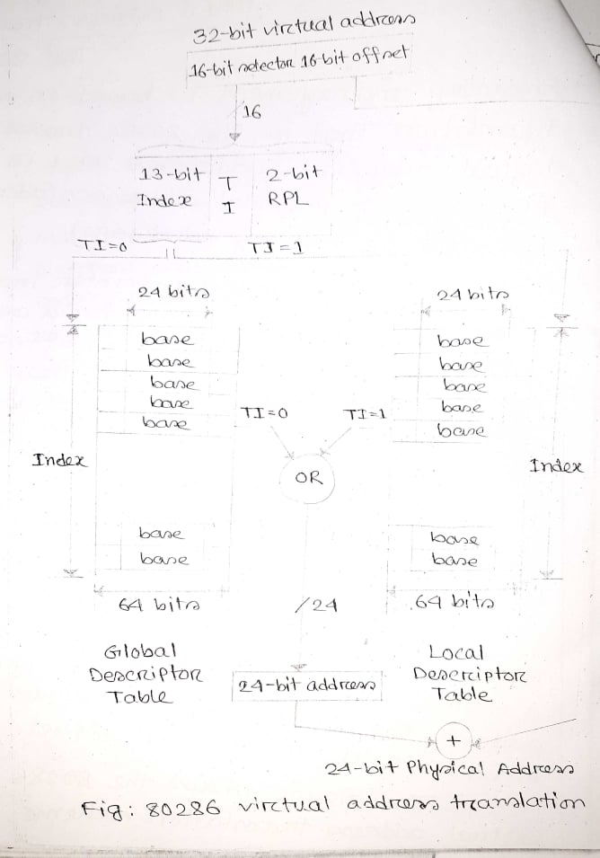
80286 Address Translation

